Slide 1
Teaching Judaism
Studies of Religion Conference 2017
Dr Louise Pryke
louise.pryke@mq.edu.au

Slide 2

Teaching Judaism
The Book of Proverbs:
Wisdom, Women, Worldliness

Slide 3
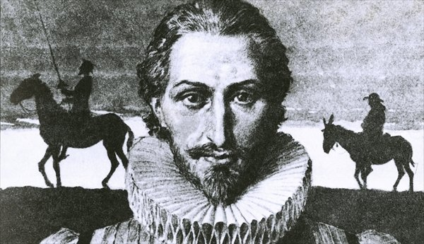
Q. What is a proverb?
A. Cervantes says proverbs are “short sentences drawn from long experience.”

Slide 4
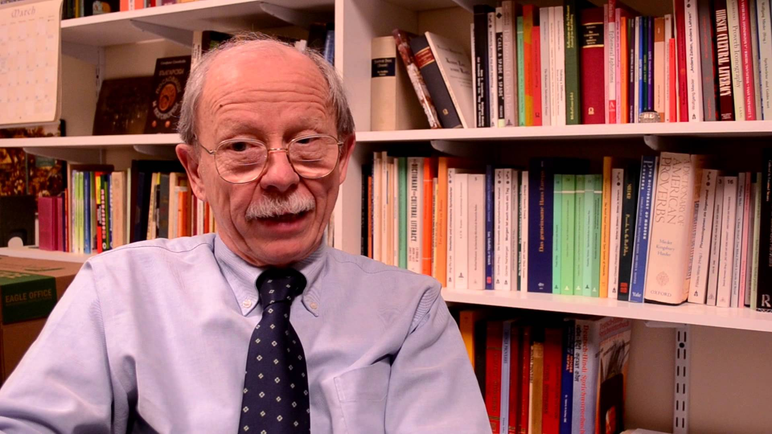
Wolfgang Mieder, Professor of Folklore at the University of Vermont has defined the proverb as:
“A short, generally known sentence of the folk which contains wisdom, truth, morals, and traditional views in a metaphorical, fixed and memorisable form and which is handed down from generation to generation.”
Paremiology is the collection and study of proverbs.

Slide 5
Teaching Judaism
Judaism is one of the world’s most ancient religions, with a history stretching back over 4000 years.
In today’s lecture, we’ll focus on the Hebrew Bible as a Sacred Text, and how it can be used to teach students about Judaism’s Core Ethical Teachings, relating to the Book of Proverbs (wisdom, righteousness, purity and generosity of spirit)

Slide 6

THE HEBREW BIBLE: A SACRED TEXT

Slide 7
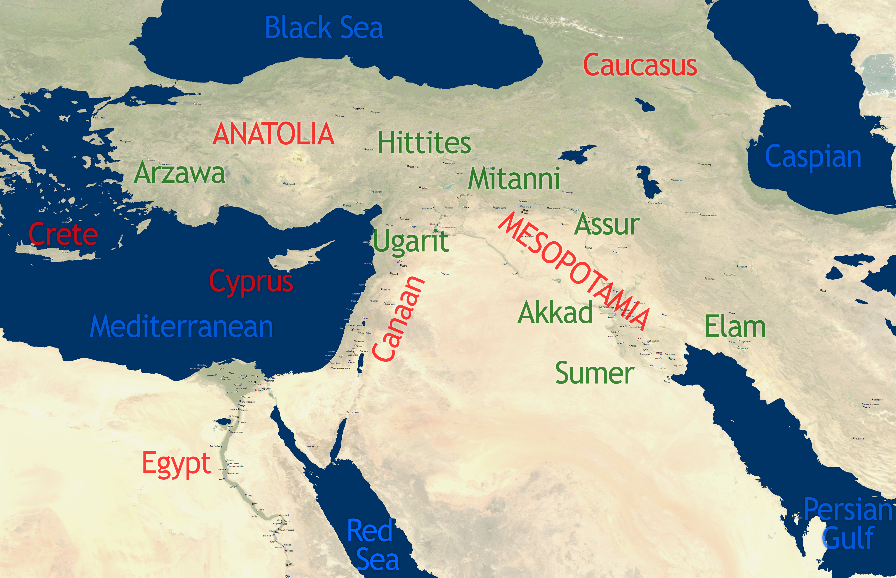
Wisdom Literature in the Ancient Near east

Slide 8
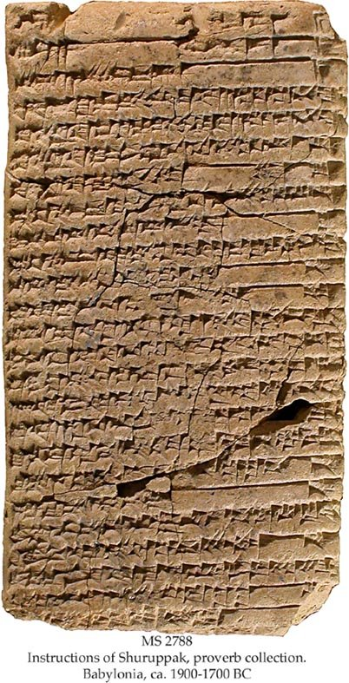
The Instructions of Shurrupag is an Sumerian wisdom composition dating to around the early third millennium BCE. Present proverbs and wisdom in instructional style, from father to son.
ancient Wisdom Literature

Slide 9
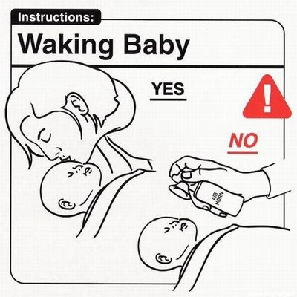
“A loving heart maintains a family; a hateful heart destroys a family.” “You should not pass judgment when you drink beer”. “You should not travel during the night: it can hide both good and evil.” “Fate is a wet bank; it can make one slip.” “Heaven is far, earth is most precious, but it is with heaven that you multiply your goods, and all foreign lands breathe under it.”
The Instructions …

Slide 10
Orality, wisdom and collective memory
“Listen, my son, to your father’s instruction
and do not forsake your mother’s teaching.” (Proverbs 1:8)
It is thought that orality may help explain some of the variations found in duplicate proverbs, where sometimes there are slight differences in wording that seem to alter the meaning of the saying:
A wise son makes a glad father,
but a foolish son is a sorrow to his mother. Proverbs 10:1
A wise son makes a glad father,
but a foolish man despises his mother. Proverbs 15: 20

Slide 11

The content of Proverbs suggests a tradition of educational processes for teaching children, and, as in the broader ANE, this seems to have involved women as well as men, such as may be seen in Proverbs 31:
“The words of King Lemuel. An oracle that his mother taught him:
What are you doing, my son? What are you doing, son of my womb? …
It is not for kings, O Lemuel,
it is not for kings to drink wine,
or for rulers to take strong drink,
lest they drink and forget what has been decreed
and pervert the rights of all the afflicted.” (Proverbs 31:1)

Slide 12
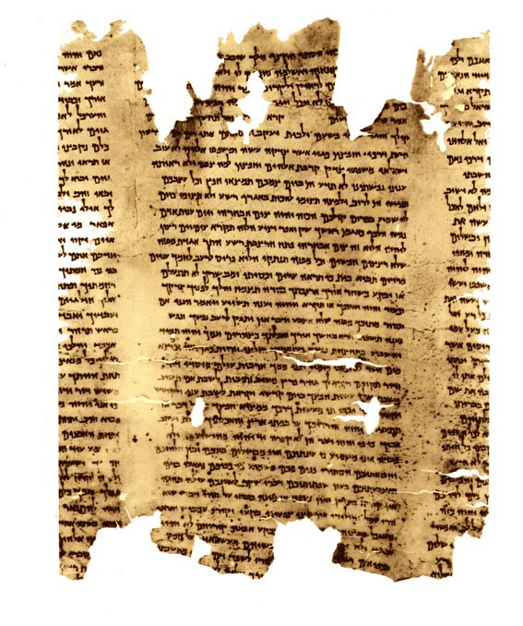
Biblical wisdom literature

Slide 13
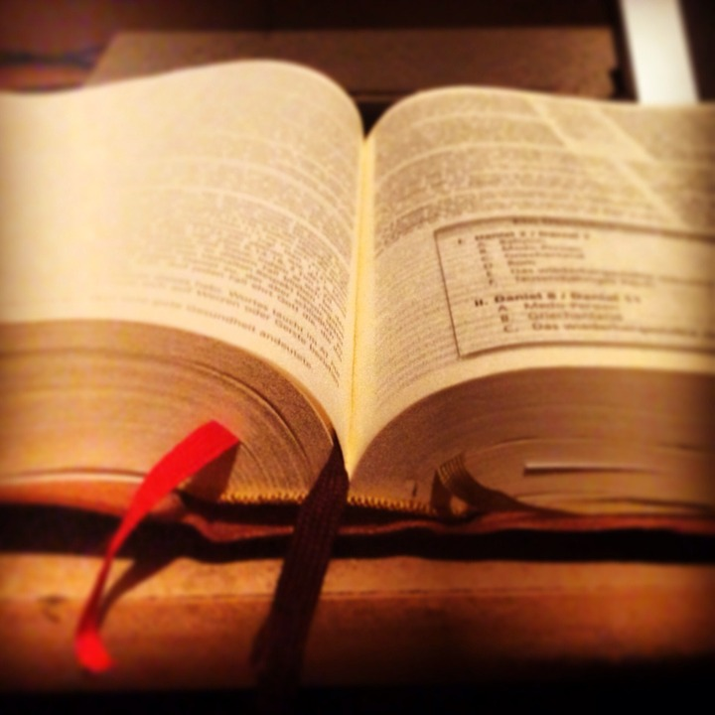
Job, Ecclesiastes and Proverbs

Slide 14
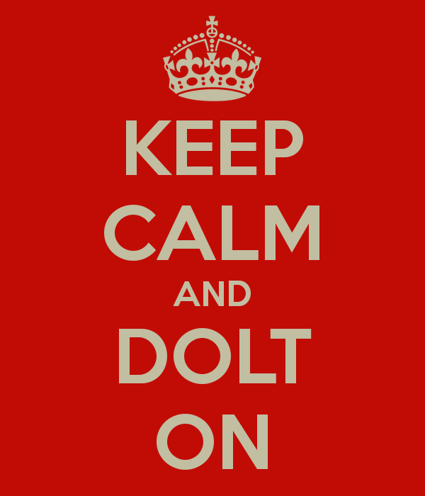
The Book of Proverbs, or What to do when one is dealing with a dolt
Answer not a fool according to his folly,
lest you be like him yourself.
Answer a fool according to his folly,
lest he be wise in his own eyes.
- Proverbs 26: 4-5.

Slide 15
The (lesser known) wisdom of Hildebrandt
“In almost every proverb collection, opposites are recorded and often juxtaposed, with the ‘contradiction’ purposefully used to break the bands of an isolated dogmatic approach and to necessitate the importance of coming to grips with the polysituational use of proverbs … the editors deliberately placed these contrary proverbs back to back. This dissonance leads one away from simplistic dualistic dogmatism to a situationally nuanced wisdom.”
- Hildebrandt, 2008.

Slide 16
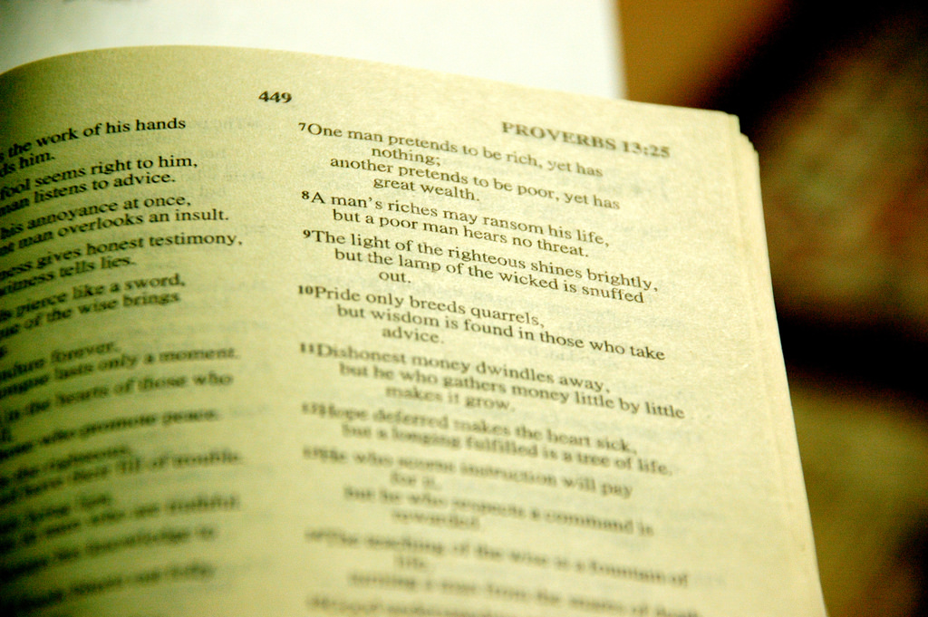
Women in Proverbs

Slide 17

The Beginning of wisdom

Slide 18

Conclusion
The wisdom books of the Hebrew Bible take a worldly and sophisticated view of the qualities of wisdom.

Slide 19
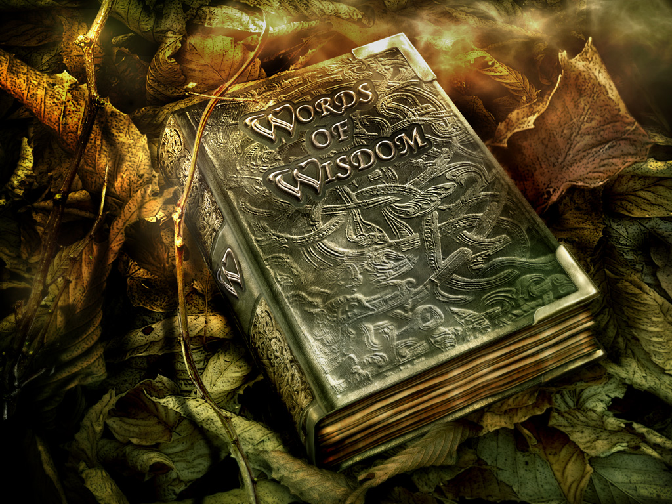
Thank you!

